Slide 1
Chapter 5
Sampling Distributions
Lecture Slides
Introduction to the Practice of Statistics
Tenth Edition
David S. Moore George P. McCabe
Bruce Craig

Slide 2
Chapter 5
Sampling Distributions
5.1 Toward Statistical Inference
5.2 The Sampling Distribution of a Sample Mean
5.3 Sampling Distributions for Counts and Proportions

Slide 3
5.1 Toward Statistical Inference
Parameters and statistics
Sampling variability
Sampling distributions
Bias and variability
Sampling from large populations

Slide 4
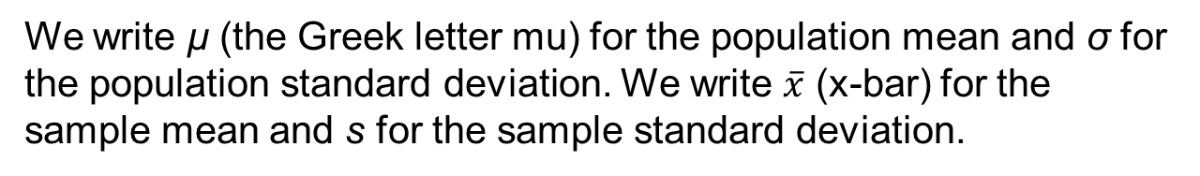
Parameters and Statistics
As we begin to use sample data to draw conclusions about a wider population, we must be clear about whether a number describes a
sample or a population.
A parameter is a number that describes some characteristic of the population. In statistical practice, the value of a parameter is not known because we cannot examine the entire population.
A statistic is a number that describes some characteristic of a sample. The value of a statistic can be computed directly from the sample data, but it can change from sample to sample. We often use a statistic to estimate an unknown parameter.
Remember s and p: statistics come from samples, and
parameters come from populations.
We write µ (the Greek letter mu) for the population mean and σ for the population standard deviation. We write $\overline{x}$ (x-bar) for the sample mean and s for the sample standard deviation.

Slide 5
Statistical Estimation
The process of statistical inference involves using information from a sample to draw conclusions about a wider population.
Different random samples yield different statistics. We need to be able to describe the sampling distribution of the possible values of a statistic in order to perform statistical inference.
The sampling distribution of a statistic consists of all possible values of the statistic and the relative frequency with which each value occurs. We may plot this distribution using a histogram, just as we plotted a histogram to display the distribution of data in Chapter 1.
Population
Sample
Collect data from a representative Sample...
Make an inference about the Population.

Slide 6
Sampling Variability
Sampling variability is a term used for the fact that the value of a statistic varies in repeated random sampling.
To make sense of sampling variability, we ask, “What would happen if we took many samples?”
Population
Sample
Sample
Sample
?
Sample
Sample
Sample
Sample
Sample

Slide 7
Sampling Distributions
If we measure enough subjects, the statistic will be very close to the unknown parameter that it is estimating.
If we took every one of the possible samples of a certain size, calculated the sample mean for each, and made a histogram of all those values, we’d have a sampling distribution.
The sampling distribution of a statistic is the distribution of values taken by the statistic in all possible samples of the same size from the same population.
In practice, it is difficult to take all possible samples of size n to obtain the actual sampling distribution of a statistic. Instead, we can use simulation to imitate the process of taking many, many samples.

Slide 8
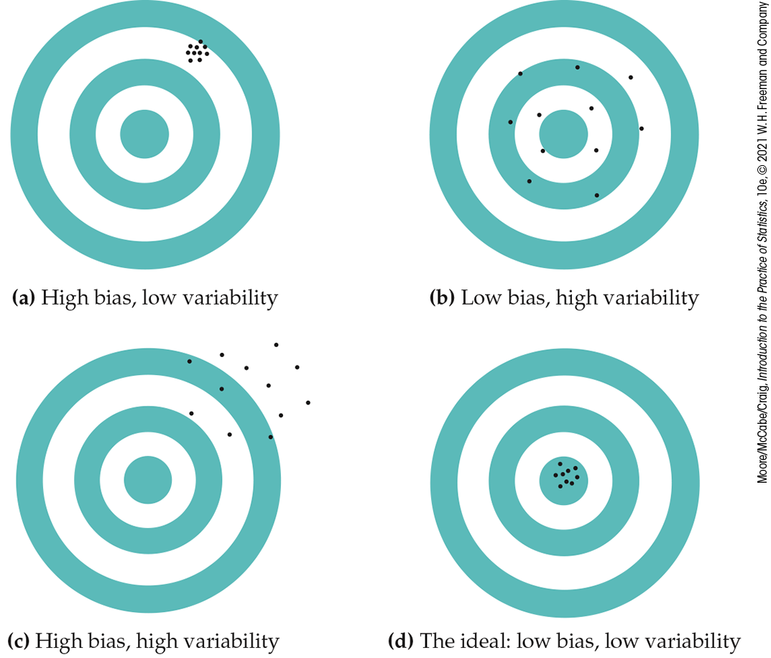
Bias and Variability
We can think of the true value of the population parameter as the bull’s-eye on a target and of the sample statistic as an arrow fired at the target. Bias and variability describe what happens when we take many shots at the target.
Bias concerns the center of the sampling distribution. A statistic used to estimate a parameter is unbiased if the mean of its sampling distribution is equal to the true value of the parameter being estimated.
The variability of a statistic is the spread of its sampling distribution. It is determined by the sampling design and the sample size n.
Statistics from larger samples have smaller spreads.

Slide 9
Managing Bias and Variability
A good sampling scheme must have both small bias and small variability.
To reduce bias, use random sampling.
To reduce variability of a statistic from an SRS, use a larger sample.
The variability of a statistic from a random sample does not depend on the size of the population, as long as the population is at least 20 times larger than the sample.

Slide 10
Why Randomize?
The purpose of a sample is to give us information about a larger population. The process of drawing conclusions about a population on the basis of sample data is called inference.
Why should we rely on random sampling?
Random sampling eliminates bias in selecting samples from the list of available individuals.
The laws of probability allow trustworthy inference about the population.
  Results from random samples come with a margin of error that sets bounds on the size of the likely error.
  Larger random samples give better information about the population than smaller samples.

Slide 11
5.2 The Sampling Distribution of a Sample Mean
Population distribution
The mean and standard deviation of the sample mean
Sampling distribution of a sample mean
Central limit theorem

Slide 12
Population Distribution
The population distribution of a variable is the distribution of values of the variable among all individuals in the population. The population distribution is also the probability distribution of the variable when we choose one individual at random from the population.
  In many examples, there is a well-defined population of interest from which SRS’s can be drawn, as when we sample students who attend a particular university.
  However, sometimes the population of interest does not actually exist. For example, the exam scores of students who took a course last semester can be thought of as a sample from a hypothetical population of students who will take the course in the future, but that population of students does not yet exist. We can still think of the observations as having come from a population with a probability distribution.

Slide 13

Mean and Standard Deviation of a Sample Mean
Mean of a sampling distribution of a sample mean
  There is no tendency for a sample mean to fall systematically above or below μ, even if the distribution of the raw data is skewed. Thus, the mean of the sampling distribution is an unbiased estimate of the population mean μ.
Standard deviation of a sampling distribution of a sample mean
  The standard deviation of the sampling distribution measures how much the sample statistic varies from sample to sample. It is smaller than the standard deviation of the population by a factor of .
  Averages are less variable than individual observations.

Slide 14
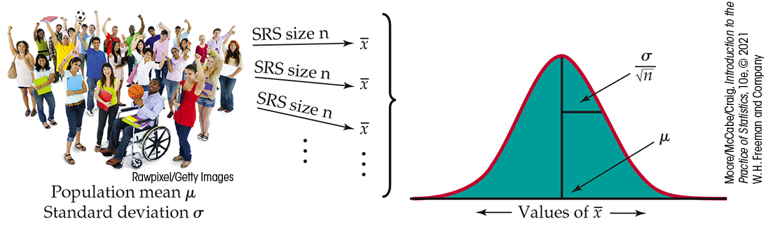
The Sampling Distribution of a Sample Mean
14
When we choose many SRSs from a population, the sampling distribution of the sample mean is centered at the population mean µ and is less spread out than the population distribution. Here are the facts:
The Sampling Distribution of Sample Means

Slide 15
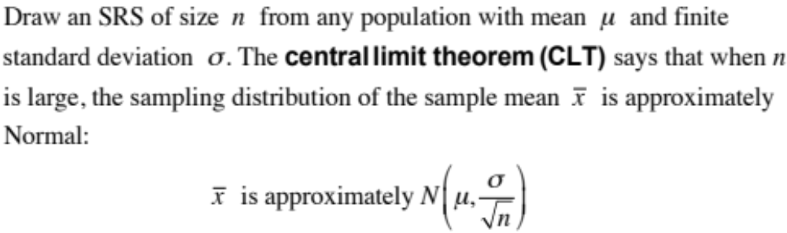
The Central Limit Theorem
Most population distributions are not Normal. What is the shape of the sampling distribution of sample means when the population distribution is not Normal?
Remarkably, as the sample size increases, the distribution of sample means begins to look more and more like a Normal distribution!
When the sample is large enough, the distribution of sample means is very close to Normal, no matter what shape the population distribution has, as long as the population has a finite standard deviation.

Slide 16
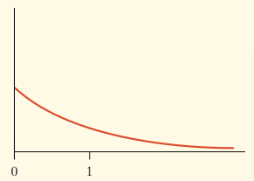

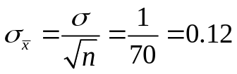
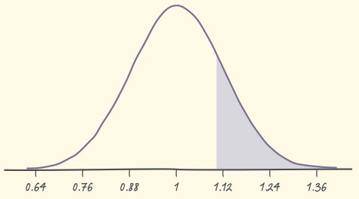
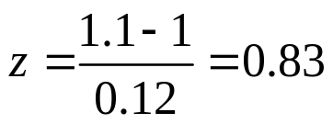
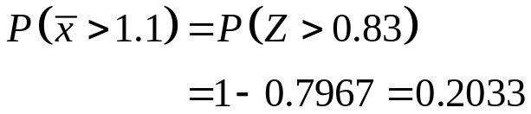
Central Limit Theorem Example
Example: Based on service records from the past year, the time (in hours) that a technician requires to complete preventive maintenance on an air conditioner follows a distribution that is strongly right-skewed and whose most likely outcomes are close to 0. The mean time is µ = 1 hour, and the standard deviation is σ = 1.
Your company will service an SRS of 70 air conditioners. You have budgeted 1.1 hours per unit. Will this be enough?
The mean and standard deviation of the sampling distribution of the average time spent working on the 70 units are
The central limit theorem says that the sampling distribution of the mean time spent working is approximately N(1, 0.12) because n = 70 ≥ 30.
If you budget 1.1 hours per unit, there is a 20% chance that the technicians will not complete the work within the budgeted time.

Slide 17
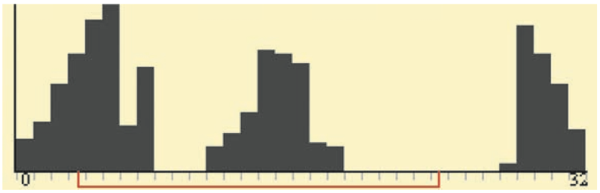
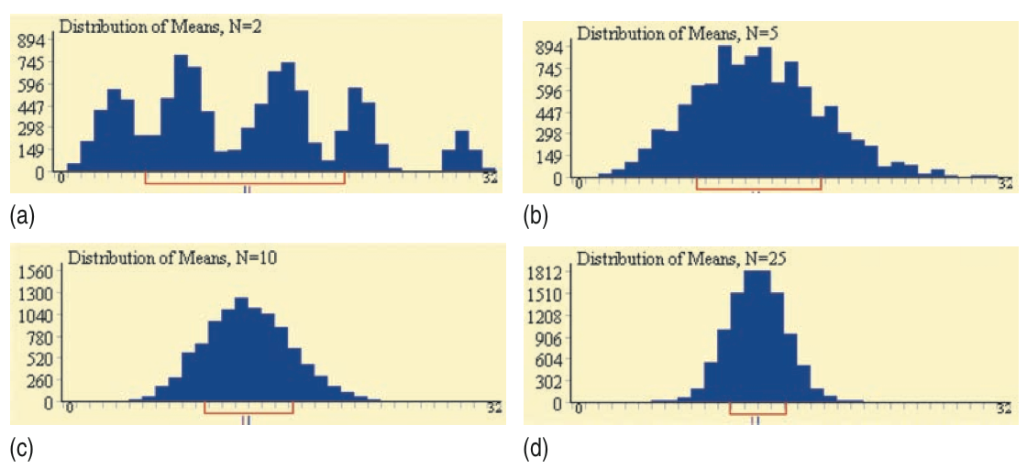
A Few More Facts
Any linear combination of independent Normal random variables is also Normally distributed.
More generally, the central limit theorem notes that the distribution of a sum or average of many small random quantities is close to Normal.
Finally, the central limit theorem also applies to discrete random variables. An average of discrete random variables will never result in a continuous sampling distribution, but the Normal distribution often serves as a good approximation.

Slide 18
5.3 Sampling Distributions for Counts and Proportions
Binomial distributions for sample counts
Binomial distributions in statistical sampling
Finding binomial probabilities
Binomial mean and standard deviation
Sample proportions
Normal approximation for counts and proportions
Binomial formula
Poisson distributions for sample counts

Slide 19
The Binomial Setting
When the same chance process is repeated several times, we are often interested in whether a particular outcome does or does not happen on each repetition. In some cases, the number of repeated trials is fixed in advance, and we are interested in the number of times a particular event (called a “success”) occurs.
A binomial setting arises when we perform several independent trials of the same chance process and record the number of times that a particular outcome occurs. The four conditions (called BINS) for a binomial setting are as follows:
Binary? The possible outcomes of each trial can be classified as “success” or “failure.”
Independent? Trials must be independent; that is, the result of one trial must not have any effect on the result of any other trial.
Number? The number of trials n of the chance process must be fixed in advance.
Success? The probability p of success must be the same on every trial.

Slide 20
Binomial Distribution
Consider tossing a coin n times. Each toss gives either heads or tails. Knowing the outcome of one toss does not change our assessment of the probability of an outcome on any other toss. If we define heads as a success, then p is the probability of a head and is 0.5 on any toss.
The number of heads in n tosses is a binomial random variable X. The probability distribution of X is called a binomial distribution.
Binomial Distribution
The count X of successes in a binomial setting has the binomial distribution with parameters n and p, where n is the number of trials of the chance process, and p is the probability of a success on any one trial. The possible values of X are the whole numbers from 0 to n.
Note: Not all counts have binomial distributions. Be sure to check the conditions for a binomial setting and make sure you are being asked to count the number of successes in a certain number of trials!

Slide 21
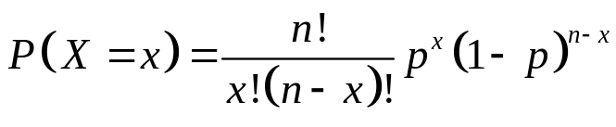
Form of the Binomial Distribution
In a binomial setting with n trials and success probability p, the probability of exactly x successes is
In this formula, x! means x(x – 1)(x – 2) . . . 2(1).
For example, 5! = 5(4)(3)(2)(1) = 120.
Note: The binomial distributions are important in statistics when we want to make inferences about the proportion p of successes in a population.

Slide 22
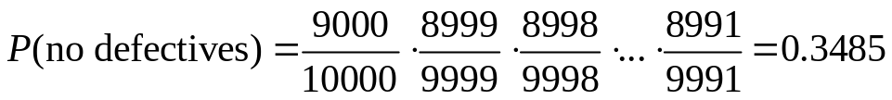
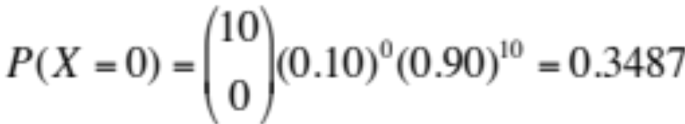
Binomial Distributions in Statistical Sampling
Example: Suppose 10% of CDs have defective copy-protection schemes that can harm computers. A music distributor inspects an SRS of 10 CDs from a shipment of 10,000. Let X = number of defective CDs in the SRS of size 10.
What is P(X = 0)?
Note: This is not quite a binomial setting. Why?
The actual probability is
Sampling Distribution of a Count
Choose an SRS of size n from a population with proportion p of successes. When the population is much larger than the sample, the count X of successes in the sample has approximately the binomial distribution with parameters n and p.
Using the binomial distribution,

Slide 23
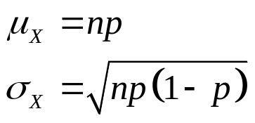
Binomial Mean and Standard Deviation
If a count X has the binomial distribution based on n observations with probability p of success, what is its mean µ?
Here are the facts:
Mean and Standard Deviation of a Binomial Random Variable
If a count X has the binomial distribution with number of trials n and probability of success p, the mean and standard deviation of X are
Note: These formulas work ONLY for binomial distributions. They cannot be used for other distributions!

Slide 24
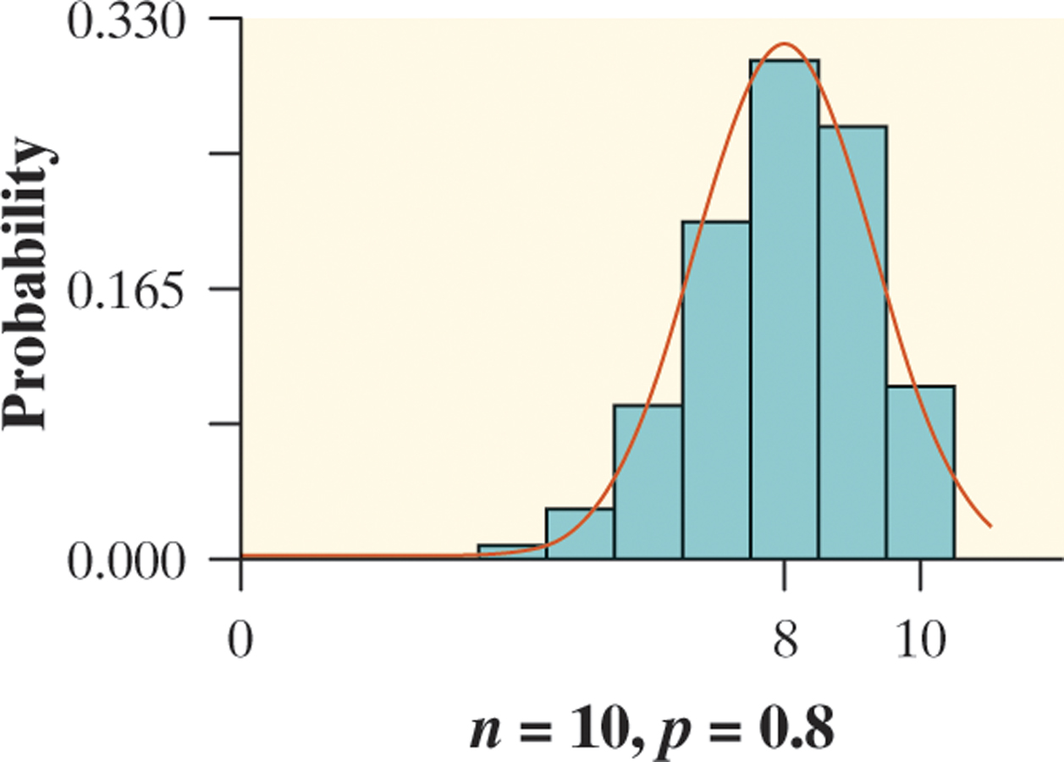
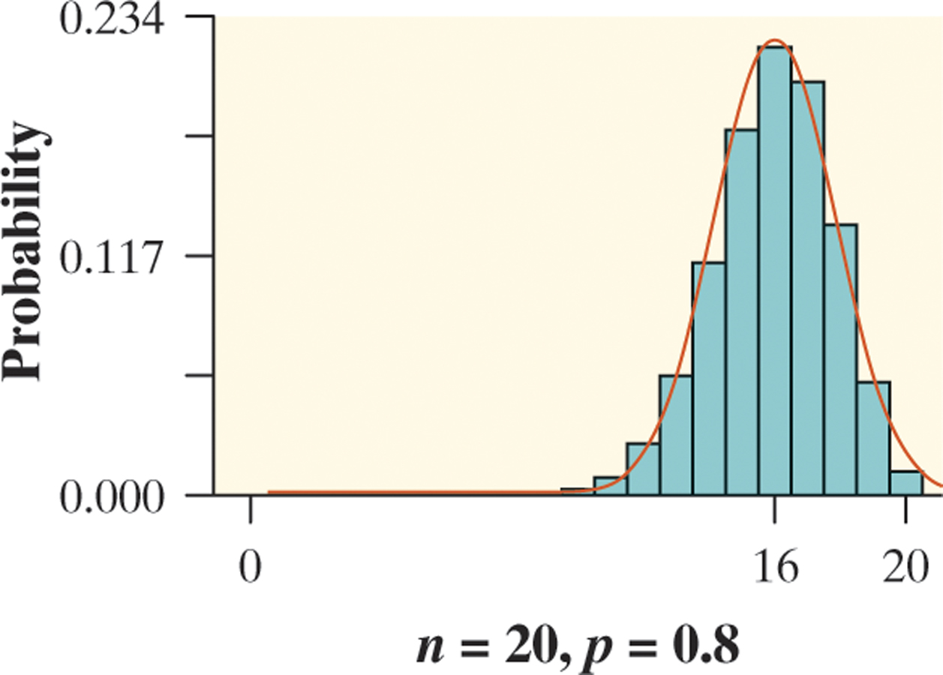
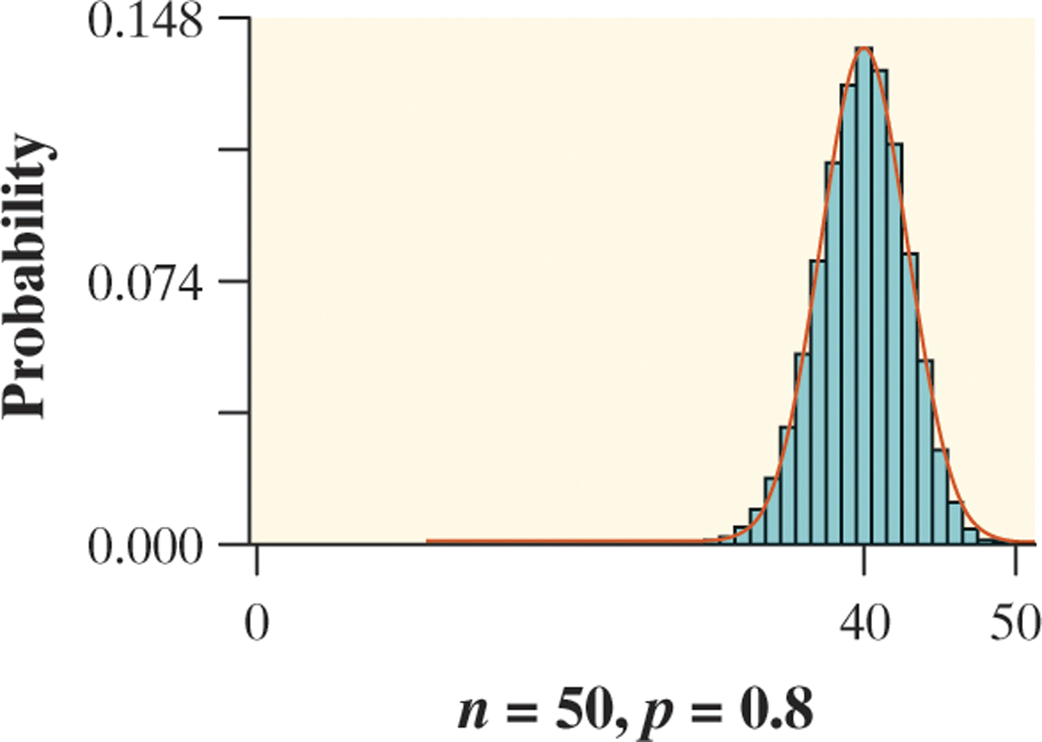

Normal Approximation for
Binomial Distributions
Observation: As n gets larger, something interesting happens to the shape of a binomial distribution.
Normal Approximation for Binomial Distributions
Suppose that X has the binomial distribution with n trials and success probability p. When n is large, the distribution of X is approximately Normal with mean and standard deviation
As a rule of thumb, we will use the Normal approximation when n is so large that np ≥ 10 and n(1 – p) ≥ 10.

Slide 25
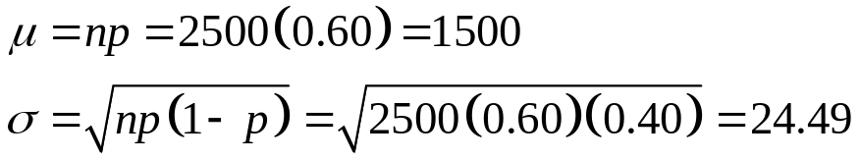
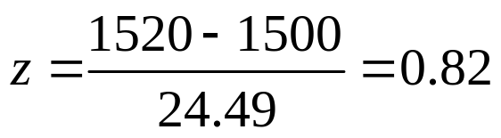
Normal Approximation
Example: Sample surveys show that fewer people enjoy shopping than in the past. A survey asked a nationwide random sample of 2500 adults if they agreed or disagreed that “I like buying new clothes, but shopping is often frustrating and time-consuming.” Suppose that exactly 60% of all adult U.S. residents would say “Agree” if asked the same question. Let X = the number in the sample who agree. Estimate the probability that 1520 or more of the sample agree.
1) Verify that X is approximately a binomial random variable.
B: Success = agree; Failure = do not agree
I: Because the population of U.S. adults is greater than 25,000, it is reasonable to assume that the 2500
trials are independent of each other.
N: n = 2500 trials of the chance process.
S: The probability of selecting an adult who agrees is p = 0.60.
2) Check the conditions for using a Normal approximation.
Because np = 2500(0.60) = 1500 and n(1 – p) = 2500(0.40) = 1000 are both at least 10, we may use the Normal approximation.
3) Calculate P(X ≥ 1520) using a Normal approximation.

Slide 26
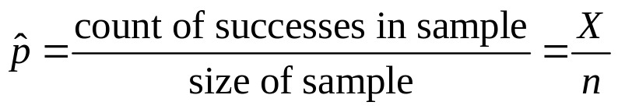
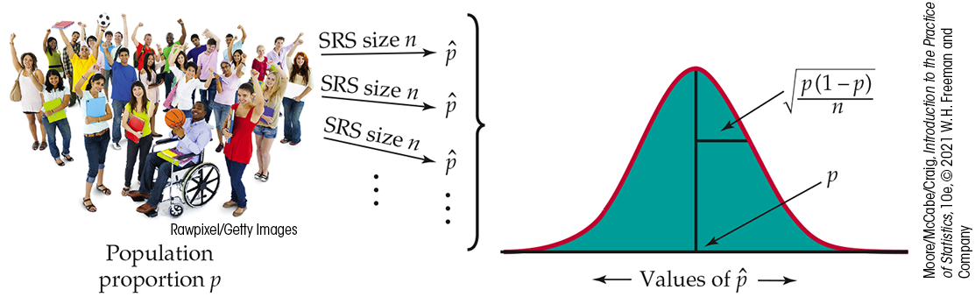
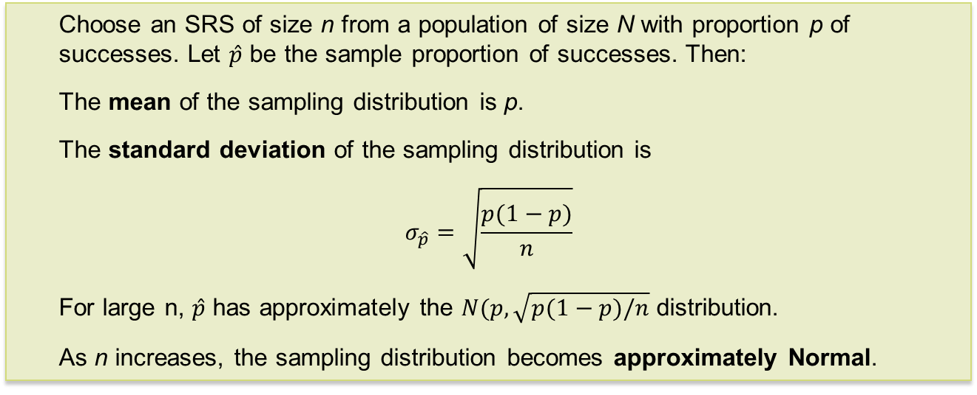
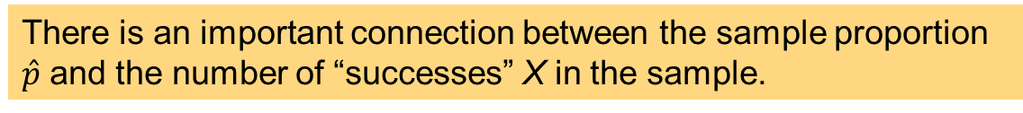
Sampling Distribution of a Sample Proportion
There is an important connection between the sample proportion $\hat{p}$ and the number of “successes” X in the sample.
Sampling Distribution of a Sample Proportion
Choose an SRS of size n from a population of size N with proportion p of successes. Let $\hat{p}$ be the sample proportion of successes. Then:
The mean of the sampling distribution is p.
The standard deviation of the sampling distribution is
$$σ_{\hat{p}}=\sqrt{\frac{p(1−p)}{n}}$$
For large n, $\hat{p}$ has approximately the $N(p,\sqrt{p(1−p)/n}$ distribution.
As n increases, the sampling distribution becomes approximately Normal.

Slide 27
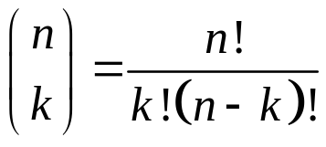
Binomial Formula
Here, we justify the expression given previously for the binomial distribution. First, we can find the chance that a binomial random variable takes any value by adding probabilities for the different ways of getting exactly that many successes in n observations.
The number of ways of arranging k successes among n observations is given by the binomial coefficient
Note: n! = n(n – 1)(n – 2) • . . . • (3)(2)(1) and 0! = 1.

Slide 28
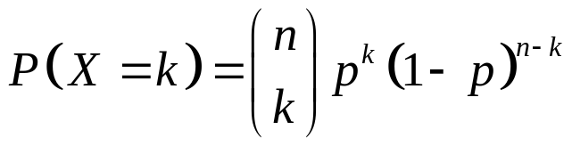
Binomial Probability (1 of 2)
The binomial coefficient counts the number of different ways in which k successes can be arranged among n trials. The binomial probability
P(X = k) is this count multiplied by the probability of any one specific arrangement of the k successes.
Binomial Probability
If X has the binomial distribution with n trials and probability p of success on each trial, the possible values of X are 0, 1, 2, . . . , n. If k is any one of these values,
Number of arrangements of k successes
Probability of n − k failures
Probability of k successes

Slide 29
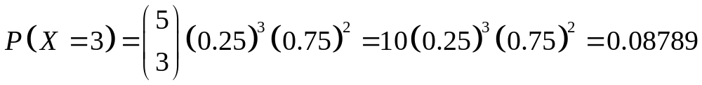
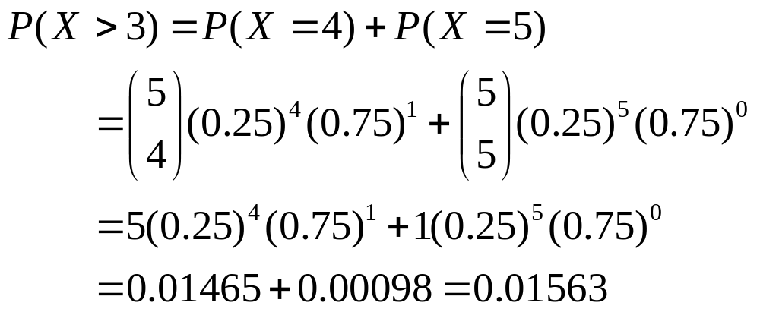
Binomial Probability (2 of 2)
Example: Each child of a particular pair of parents has probability 0.25 of having blood type O. Suppose the parents have five children.
(a) Find the probability that exactly three of the children have type O blood.
Let X = the number of children with type O blood. We know X has a binomial distribution with n = 5 and p = 0.25.
(b) Should the parents be surprised if more than three of their children have type O blood?
Because there is only a 1.5% chance that more than three children out of five would have Type O blood, the parents should be surprised!

Slide 30
Poisson Setting
Frequently, we meet counts that are open-ended:
  The number of customers at a café between noon and 1:00 p.m.
  The number of dings on your car door
  The number of reported pedestrian/bicyclist collisions on campus during an academic year
A Poisson setting arises when we consider the number of successes that occur in a fixed unit of measure, such as a period of time or a region of space.
Conditions for the Poisson Distribution
The numbers of successes that occur in two non-overlapping units of measure are independent.
The probability that a success will occur in a unit of measure is the same for all units of equal size and is proportional to the size of the unit.
The probability that more than one event occurs in a unit of measure is negligible for very small units. In other words, the events occur one at a time.

Slide 31
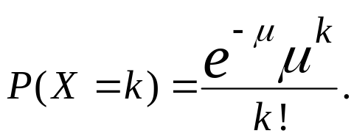

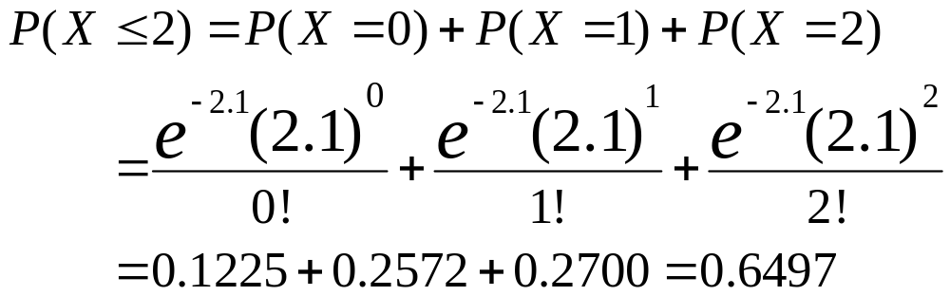
Poisson Distribution
Poisson Probability
If X has the Poisson distribution with mean μ, the possible values of X are 0, 1, 2, 3, . . . . If k is any whole number,
The standard deviation of the distribution is .
Example: Suppose the number of dropped calls on your cell phone varies, with an average of 2.1 calls per day. If we assume the Poisson setting is reasonable, we can model the daily count of dropped calls X using the Poisson distribution with μ = 2.1. What is the probability of having no more than two dropped calls tomorrow?
There is roughly a 65% chance that you will have no more than two dropped calls tomorrow.

Slide 32
Chapter 5
Sampling Distributions (Review)
5.1 Toward Statistical Inference
5.2 The Sampling Distribution of a Sample Mean
5.3 Sampling Distributions for Counts and Proportions

